Slide 1
Linear regression implementation
Shoaib Azmat
Department of Electrical and Computer Engineering
CUI, Abbottabad

Slide 2
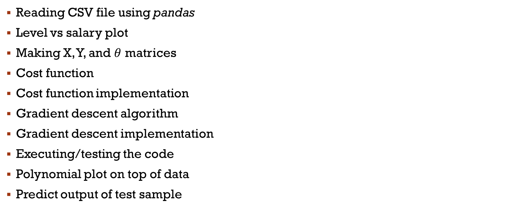
outline
Reading CSV file using pandas
Level vs salary plot
Making X, Y, and $θ$ matrices
Cost function
Cost function implementation
Gradient descent algorithm
Gradient descent implementation
Executing/testing the code
Polynomial plot on top of data
Predict output of test sample

Slide 3
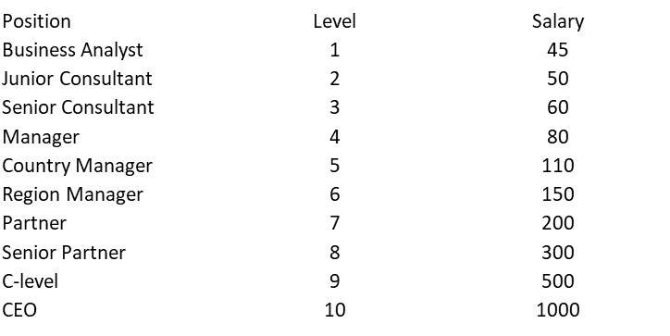
Reading CSV file using pandas
import numpy as np
import pandas as pd
import matplotlib.pyplot as plt
data = pd.read_csv('posal.csv')
print(data.shape)
print(data)
#data.head()
CSV file in excel

Slide 4
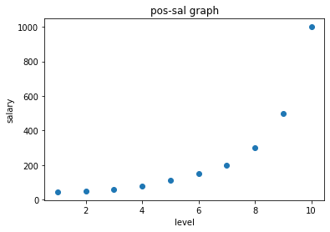
Level vs salary plot
x1 = data['Level'].values
sal=data['Salary'].values
plt.scatter(x1, sal)
plt.title("pos-sal graph")
plt.xlabel("level")
plt.ylabel("salary")
plt.show()

Slide 5

Making X, Y, and $θ$ matrices
x1 = data['Level'].values, x1s=x1/np.max(x1)
x2 = x1**2, x2s=x2/np.max(x2)
x3 = x1**3, x3s = x3/np.max(x3)
x4 = x1**4, x4s = x4/np.max(x4)
Y=data['Salary'].values
m = len(x1)
x0 = np.ones(m)
X = np.array([x0,x1s,x2s,x3s,x4s]).T
theta = np.array([0, 0, 0, 0, 0])
array([[1.000e+00, 1.000e-01, 1.000e-02, 1.000e-03, 1.000e-04],
[1.000e+00, 2.000e-01, 4.000e-02, 8.000e-03, 1.600e-03],
[1.000e+00, 3.000e-01, 9.000e-02, 2.700e-02, 8.100e-03],
[1.000e+00, 4.000e-01, 1.600e-01, 6.400e-02, 2.560e-02],
[1.000e+00, 5.000e-01, 2.500e-01, 1.250e-01, 6.250e-02],
[1.000e+00, 6.000e-01, 3.600e-01, 2.160e-01, 1.296e-01],
[1.000e+00, 7.000e-01, 4.900e-01, 3.430e-01, 2.401e-01],
[1.000e+00, 8.000e-01, 6.400e-01, 5.120e-01, 4.096e-01],
[1.000e+00, 9.000e-01, 8.100e-01, 7.290e-01, 6.561e-01],
[1.000e+00, 1.000e+00, 1.000e+00, 1.000e+00, 1.000e+00]])

Slide 6
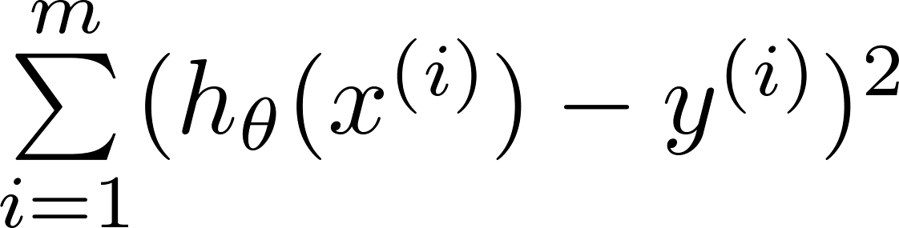
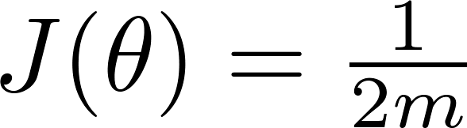
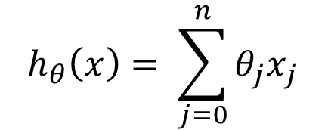
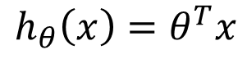
Cost function
$$h_{θ}\left(x\right)= \sum_{j=0}^{n}{θ_{j}x_{j}}$$
$$h_{θ}\left(x\right)=θ^{T}x$$

Slide 7
Cost function Vectorized implementation

Slide 8
Cost function Vectorized implementation
def cost_function(X, Y, theta):
m = len(Y)
J = np.sum((X.dot(theta) - Y) ** 2)/(2 * m)
return J

Slide 9

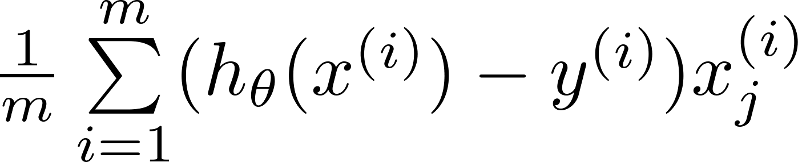
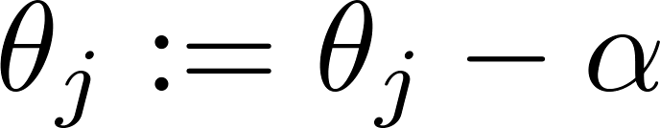
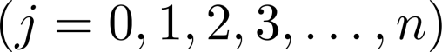

Gradient descent algorithm
Repeat

Slide 10
Gradient descent vectorized implementation

Slide 11
Gradient descent vectorized implementation

Slide 12
Gradient descent vectorized implementation
def gradient_descent(X, Y, theta, alpha, iterations):
cost_history = np.zeros(iterations)
m = len(Y)
for iteration in range(iterations):
h_theta = X.dot(theta) # Model value
loss = h_theta - Y # Difference b/w model and actual Y
gradient = X.T.dot(loss) / m # All partial derivatives in one line
theta = theta - alpha * gradient # Updating theta
cost = cost_function(X, Y, theta) # New cost value
cost_history[iteration] = cost
return theta, cost_history

Slide 13
Executing/testing the code
# learning rate
alpha = 0.0001
inital_cost = cost_function(X, Y, theta)
print("Initial Cost“, inital_cost)
# 1000000 Iterations
finaltheta, cost_history = gradient_descent(X, Y, theta, alpha, 1000000)
print(“Final Coefficients“, finaltheta) # final model parameters theta
print("Final Cost“, cost_history[-1]) # final cost

Slide 14
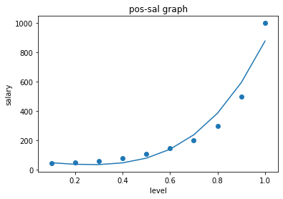
polynomial plot on top of data
h_theta = X.dot(finaltheta) # Final Model
plt.scatter(x1, sal)
plt.plot(x1,h_theta)
plt.title("pos-sal graph")
plt.xlabel("level")
plt.ylabel("salary")
plt.show()

Slide 15
Predict output of test sample
s=6.5
sample = np.array([1,s/np.max(x1),s**2/np.max(x2),s**3/np.max(x3),s**4/np.max(x4)])
predsal = sample.dot(finaltheta)
>>>print(predsal)
>>>184

